Slide 1
Investigating the Relationship Between Spreads of NFL Games and NFL Game Type
By: Luke Abbatessa & John McCarthy

Slide 2
PROBLEM STATEMENT AND BACKGROUND
Problem: Whether or not a game in the National Football League (NFL) being a playoff game or not impacts the size of the spread of the game
Hypotheses:
-Null: The average spread for regular season games is equal to the average spread for playoff games
-Alternative: The average spread for regular season games is NOT equal to the average spread for playoff games

Slide 3
PROBLEM STATEMENT AND BACKGROUND (CONT.D)
Data comes from dataset on kaggle titled “NFL scores and betting data”
-the specific file we were interested in was “spreadspoke_scores.csv”
Characteristics of the data:
-info about the NFL schedule date, season, and week for the NFL games included in the file
-whether the games were playoff games or not
-the home team and its score for the games
-the away team and its score for the games
-the abbreviated name of the team favored to win the games
-the spread of the games
-the over-under line for total points scored by both teams in each game
-the stadium where the games were played and whether it was neutral or not
-info about the weather of the days the games were played (e.g. temp, wind in mph, humidity, qualitative detail)

Slide 4
INTRODUCTION AND DESCRIPTION OF THE DATA
We obtained the data from kaggle, a popular data science community with many public datasets and data science tools
The problem of comparing game type to spread size is important because sports betting data is extremely prevalent in the world today, and a comparison such as this could further inform bettors of the implied odds and their relationship to winning a specific bet
Considering the immense amount of consumer money at risk in betting (fans bet ~$100 billion during the NFL season through official licensed sportsbooks such as FanDuel), it is imperative that bettors have the best/most information to make a truly informed decision

Slide 5
METHODS
COMPUTATIONS
avg_spread
standard_deviation
t_statistic
READ IN THE DATA
csv_lines
CLEAN THE DATA
get_spreads
count_null_spreads
clean_spreads
convert _to_float
VISUALIZATIONS
plot_bar_chart
plot_histograms

Slide 6
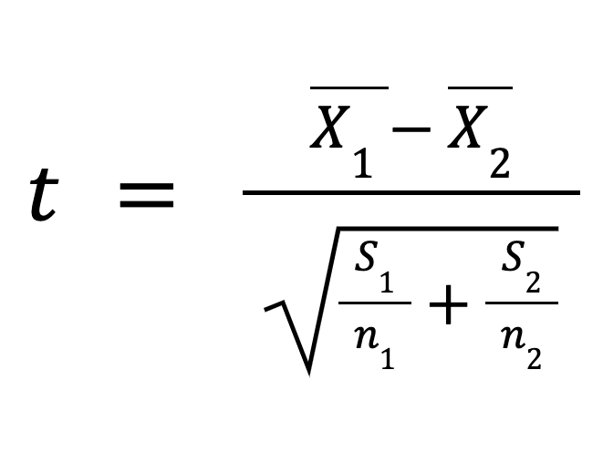
METHODS (CONT.D)
We implemented a two-sample t-test
We compare our t value with the critical value
Critical Value
invT(area = .975 , df = 10498) = 1.98

Slide 7
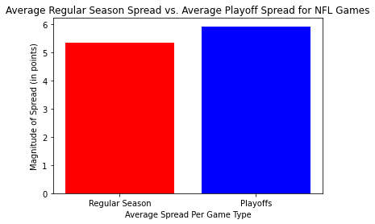
RESULTS
Average Spread for NFL Regular Season Games = 5.355 points
Average Spread for NFL Playoff Games = 5.930 points
BUT IS THIS SIGNIFICANT?
Figure 1. Bar graph comparing the average spread for NFL regular season games versus NFL playoff games

Slide 8
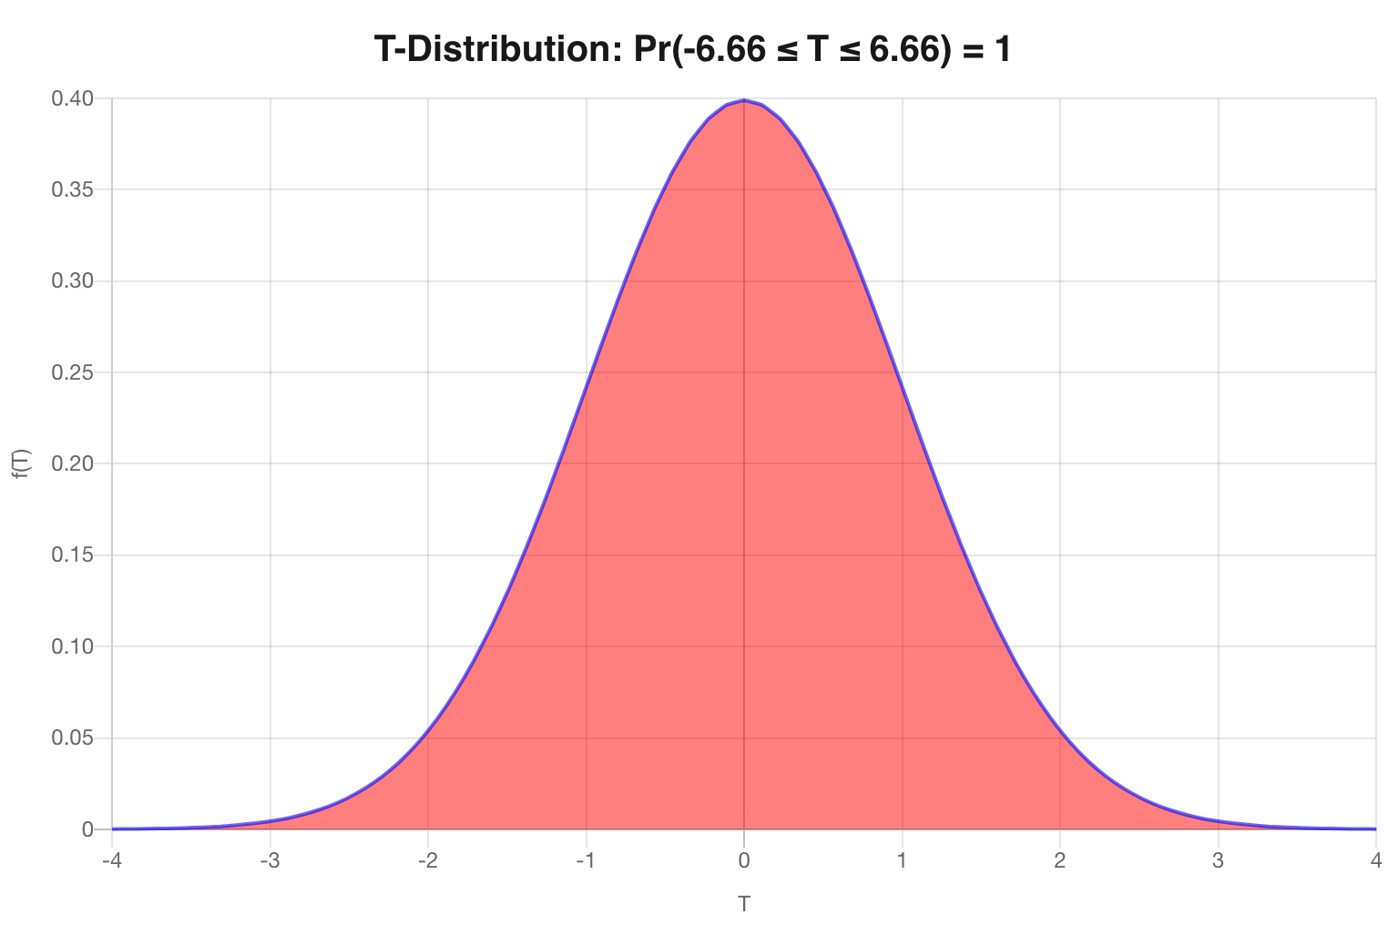
RESULTS (CONT.D)
critical value (lower tail) critical value (upper tail)
t-test statistic = 6.664
degrees of freedom = 10,498
critical value(𝞪=0.05) = 1.98
Since our t-statistic is more extreme than the critical value, we reject the null hypothesis and conclude there is a difference between the average spread for regular season games and the average spread for playoff games
(generated from mathcracker.com)
Figure 2. t-distribution demonstrating that 95% of our data falls in between the upper and lower tails and the remaining 5% of our data encompasses those tails

Slide 9
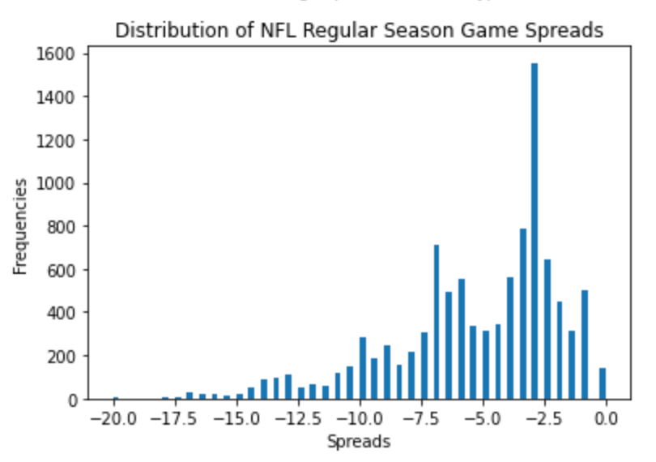
RESULTS (CONT.D)
Data are considerably skewed to the left
-they are negatively skewed
The most frequent NFL regular season game spread was roughly -3 points
The three most infrequent NFL regular season game spreads were roughly -17.5 points, -18 points, and -20 points
Figure 3. Histogram visualizing the distribution of spreads for NFL regular season games

Slide 10
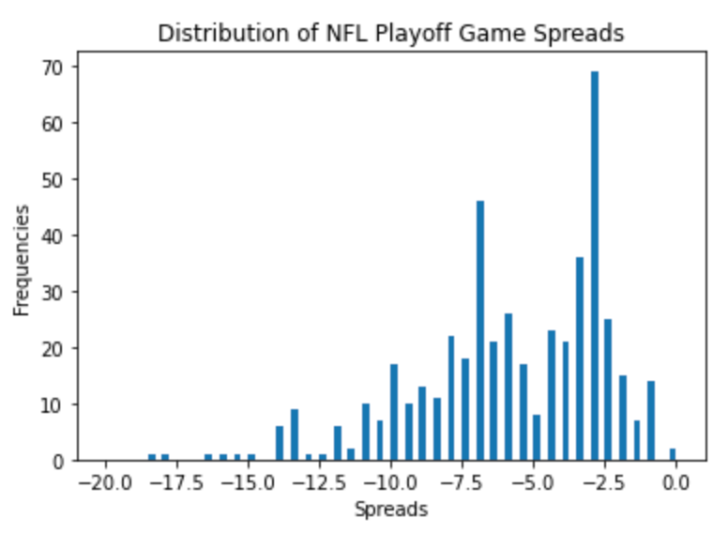
RESULTS (CONT.D)
Data are skewed to the left
-they are negatively skewed
The most frequent NFL playoff game spread was roughly -3 points
The eight most infrequent NFL playoff game spreads were roughly -12.5 points, -13 points, -15 points, -15.5 points, -16 points, -16.5 points, -18 points, and -18.5 points
Figure 4. Histogram visualizing the distribution of spreads for NFL playoff games

Slide 11
CONCLUSIONS AND FUTURE WORK (CONT.D)
Shortcomings:
-the major one was that, from 1966 up until 1978, there were very few spreads in the data
>we were limited in what data we could pull for those years → we may not have gotten the most accurate representation of the spreads in playoff games versys non-playoff games for those years
>had we had more time, one way we could have alleviated this issue was to interpolate on the data

Slide 12
CONCLUSIONS AND FUTURE WORK
Strengths:
-this project allowed us to take on a dataset and its accompanying files, pick apart the variables and specific data we were interested in, and extract trends and other findings from the data
-a significant aspect of the project was data visualization and analysis, which are two crucial aspects of data science as a whole
-we were fortunate enough to use the skills we had learned and apply them to a real-life dataset, not too different from what we may be doing post-graduation, depending on our career field

Slide 13
WORKS CITED
Data to Fish. (2020) How to Plot a Line Chart in Python using Matplotlib. https://datatofish.com/line-chart-python-matplotlib/.
GeeksforGeeks. (2021) stdev() methods in Python statistics module. https://www.geeksforgeeks.org/python-statistics-stdev/.
JournalDev. (2018) Python Remove Character from String. https://www.journaldev.com/23674/python-remove-character-from-string.
kaggle. (2021) NFL scores and betting data (v12) [Dataset] Retrieved from https://www.kaggle.com/tobycrabtree/nfl-scores-and-betting-data?select=spreadspoke_scores.cs.
Legal Sports Betting. (2021) How Much Money Do Americans Bet On Sports? https://www.legalsportsbetting.com/how-much-money-do-americans-bet-on-sports/.
mathcracker. T-Distribution Probability Calculator. https://mathcracker.com/t-distribution-calculator#results
towards data science. (2018) Get Started: 3 Ways to Load CSV files into Colab. https://towardsdatascience.com/3-ways-to-load-csv-files-into-colab-7c14fcbdcb92.
University of Sussex, School of Engineering and Informatics. t-testtable.htm. http://users.sussex.ac.uk/~grahamh/RM1web/t-testcriticalvalues.pdf.

